Slide 1
Pneumonia Detection
Utilizing CNN for Accurate Diagnosis

Slide 2
Introduction
This presentation outlines the development of a convolutional neural network (CNN)-based system for the early detection of pneumonia, focusing on the objectives, methodologies, and expected outcomes.

Slide 3
01
Objective

Slide 4
Define the purpose of pneumonia detection
The main purpose of pneumonia detection is to identify the presence of pneumonia in patients at an early stage, allowing for timely medical intervention. Effective detection systems can significantly reduce health complications and improve patient outcomes.

Slide 5
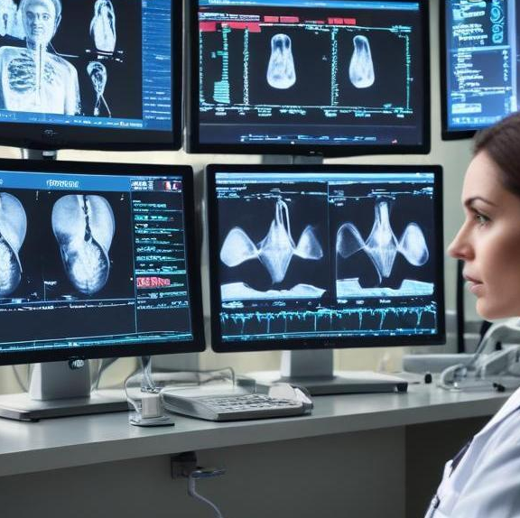
Importance of early detection
Early detection of pneumonia is crucial as it can lead to prompt treatment, potentially saving lives. It helps in minimizing the severity of the disease, reduces healthcare costs, and improves recovery rates. An efficient detection system ensures that healthcare providers are alerted to potential cases before symptoms escalate.

Slide 6
Goals of the proposed system
The primary goals of the proposed system include developing a robust and accurate pneumonia detection model utilizing convolutional neural networks (CNNs). The system aims to enhance diagnostic precision, reduce the time from detection to treatment, and ultimately improve patient outcomes by providing healthcare professionals with reliable tools for early intervention.

Slide 7
02
Proposed System

Slide 8
Overview of the new detection method
The proposed detection method leverages deep learning techniques, specifically CNNs, to analyze medical imaging data, such as chest X-rays. This system preprocesses images for optimal clarity and uses trained models to classify images as normal or indicative of pneumonia. The automation of this process aims to assist radiologists in diagnostics, making it faster and more efficient.

Slide 9
CNN architecture specifics
The CNN architecture comprises multiple convolutional layers followed by pooling layers to extract relevant features from input images. This network also includes fully connected layers at the end to make classifications. The architecture is designed to minimize overfitting through techniques such as dropout and batch normalization, ensuring high accuracy in diverse datasets.

Slide 10
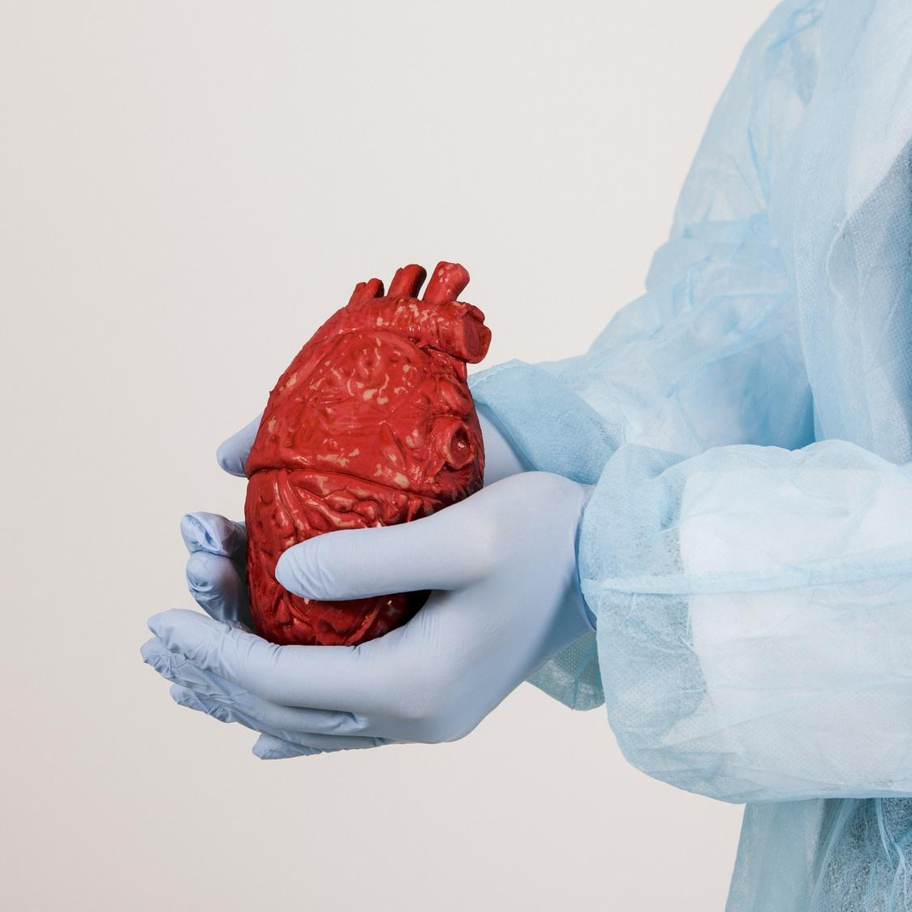
Advantages over existing systems
The proposed system offers several advantages over traditional methods. It reduces the dependency on manual analysis, thus decreasing human error and variability. Moreover, its capability to process large datasets allows for improved learning and generalization across varied patient populations, potentially leading to better overall diagnostic outcomes.

Slide 11
Conclusions
The implementation of a CNN-based pneumonia detection system represents a significant advancement in medical diagnostics. By facilitating earlier detection through innovative technology, this system can help improve patient care and streamline workflow within healthcare facilities, ultimately leading to better health outcomes.

Slide 12
Thank you!
Do you have any questions?
Thank you!

